Slide 1

Time log Application
Authenticated user
Upload File
Search Criteria
Project list
Employee list
Activity list
Generate Reports
Date Range
Employee list
Maintain history of uploaded data
Export To Excel
Select Single Employee
Other users
Show individual employee details

Slide 2
Task Allocations
Group A:
Authentication authorization functionality.
Group B:
File upload functionality with all validations.
Group C:
Employee Details Project Wise functionality with filtrations criteria and individual summary.
Group D:
Activity: Multiple filtrations criteria with employee details.

Slide 3
Login Screen
1. Users Table (Authentication)
This table stores information about users who can log in to the system.
Columns:
UserID (Primary Key): Unique identifier for each user.
Username: User's chosen username.
Email: User's email address, can also be used as an alternative to Username for logging in.
PasswordHash: Hashed password for security purposes. Never store passwords in plain text.
Salt: A unique value used for each user to enhance the security of the hashed password.
CreatedAt: Timestamp of when the user account was created.
LastLogin: Timestamp of the user's last login. Useful for tracking activity and identifying inactive accounts.
Script
CREATE TABLE Users (
UserID INT AUTO_INCREMENT PRIMARY KEY,
Username VARCHAR(255) NOT NULL,
Email VARCHAR(255) NOT NULL UNIQUE,
PasswordHash VARBINARY(64) NOT NULL,
Salt VARBINARY(64) NOT NULL,
CreatedAt DATETIME NOT NULL,
LastLogin DATETIME
);

Slide 4
Roles Table (Authorization)
2. Roles Table (Authorization)
This table defines the roles or groups within your application (e.g., admin, Manager).
Columns:
RoleID (Primary Key): Unique identifier for each role.
RoleName: Name of the role (e.g., Admin, Manager).
CREATE TABLE Roles (
RoleID INT AUTO_INCREMENT PRIMARY KEY,
RoleName VARCHAR(255) NOT NULL UNIQUE
);
3. UserRoles Table (Linking Users and Roles)
This table links users to their roles, allowing for many-to-many relationships (a user can have many roles, and a role can have many users).
Columns:
UserID: Foreign Key from the Users table.
RoleID: Foreign Key from the Roles table.
CREATE TABLE Roles (
RoleID INT AUTO_INCREMENT PRIMARY KEY,
RoleName VARCHAR(255) NOT NULL UNIQUE
);

Slide 5
Upload Functionality
Authorization
Only managers can upload the excel
Choose file
Can select only Excel/CSV file
If file is not selected, then there will some message
Upload button
Should call the server
On server side there should be data validation
After successful upload there will some message or validation errors

Slide 6
3 a ) Should call the server
Validations
Check file formats and file validations on server side if file is valid or not.
Check for duplicate record.
Check existing records with uploaded excel
If No records are macheted then proceed for record insertion
if Yes check how many records are conflicting. Fetch all records and return to the UI.
There will be confirmation box. If user want to update the records for all or cancel.
Record Insertion
List all the records in one list/object and bulk insert into DB.
If records are inserted, then message will be there or error message

Slide 7
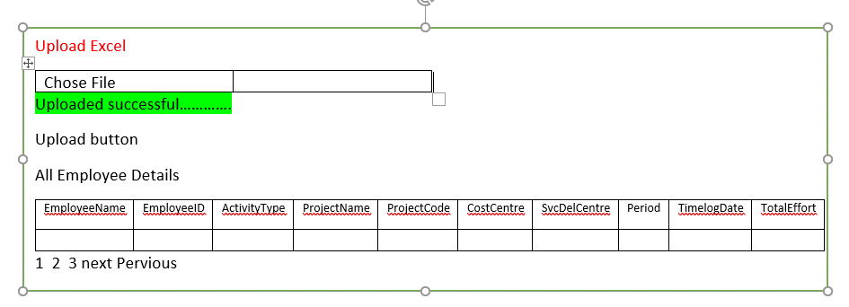

Slide 8
Employee Details Project Wise
Dropdown Project Code
One Api call which will fetch all list of project codes will available.
After selecting project code in the grid will display data project wise.
Date Range filters
Choose the start and end dates for the time period you want to filter.
Filter button
Use the filter option within your time tracking tool and input the selected date range
Export to Excel
Whatever the data displayed in the grid data should export in excel.
Grid
The grid shown data as below screen

Slide 9
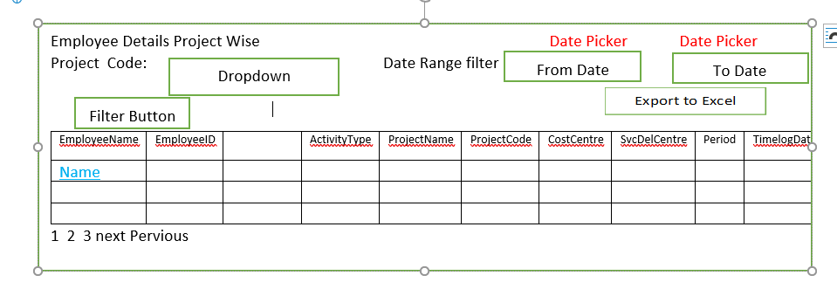
After applying the filter, generate a summary report that includes present count (time worked) and leave count for each individual employee.

Slide 10
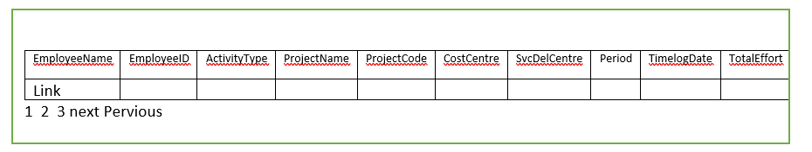
Individual Employee Summary
Employee summary
List of activities
Leaves count
No of days worked
Discrepancy
Charts
Grid

Slide 11
Activity
Filters
Project Code Dropdown
Api call which will fetch all list of project codes and bind on dropdown.
Activity Type Dropdown
Api call which will fetch all list of activities and bind on dropdown.
Identify the specific activities or tasks you want to filter by.
Employee name Multi select
Api call which will fetch all list of Employee and bind on dropdown with multiple select options.
multi-select dropdown for employee names in a web application allows users to select multiple employees at once from a dropdown list.
Date Range Filter
Choose the start and end dates for the time period you want to filter.

Slide 12
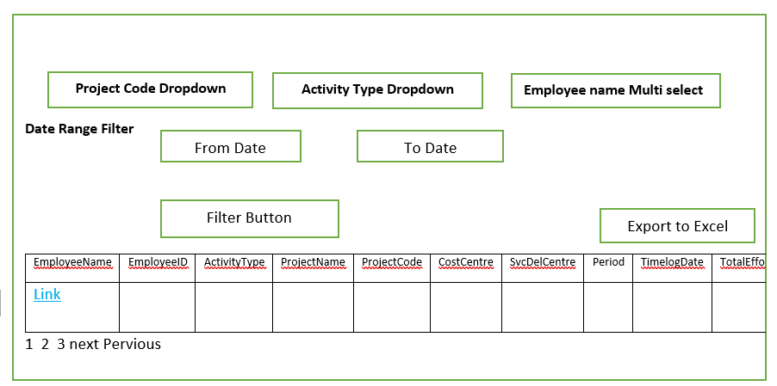
Grid

Slide 13
CREATE TABLE [dbo].[TimeLog]( [Id] [int] IDENTITY(1,1) NOT NULL, [EmployeeName] [nvarchar](50) NULL, [EmployeeID] [bigint] NULL, [ActivityType] [varchar](50) NULL, [ProjectName] [varchar](100) NULL, [ProjectCode] [varchar](50) NULL, [CostCentre] [bigint] NULL, [SvcDelCentre] [bigint] NULL, [ProjectType] [varchar](50) NULL, [ProjectManager] [varchar](50) NULL, [ProjectDirector] [varchar](50) NULL, [ProjectDeliveryLead] [varchar](50) NULL, [Level1] [varchar](50) NULL, [Level2] [varchar](50) NULL, [ActivityGroup] [varchar](50) NULL, [TaskType] [varchar](100) NULL, [TaskUniqueID] [varchar](50) NULL, [TaskName] [varchar](100) NULL, [Remark] [varchar](250) NULL, [Period] [varchar](50) NULL, [TimelogDate] [date] NULL, [Effort] [int] NULL, [TotalEffort] [int] NULL, [CreatedDate] [datetime] NULL, [UpdatedTime] [datetime] NULL, [HomeBaseDivision] [varchar](100) NULL, [HomeBaseCentre] [int] NULL, [HomeBaseTeam] [char](1) NULL, [ProjectBaseDivision] [varchar](100) NULL, [ProjectBaseCentre] [int] NULL, [ProjectBaseTeam] [char](1) NULL, [JoiningDate] [date] NULL, [LeavingDate] [date] NULL, [ProjectPlannedEffort(SingtelEDMSOnly)] [decimal](18, 0) NULL, [AM(forBidSupport)] [varchar](50) NULL, [AMbusinesscentre(forBidSupport)] [varchar](50) NULL, CONSTRAINT [PK_TimeLog] PRIMARY KEY CLUSTERED ( [Id] ASC )WITH (PAD_INDEX = OFF, STATISTICS_NORECOMPUTE = OFF, IGNORE_DUP_KEY = OFF, ALLOW_ROW_LOCKS = ON, ALLOW_PAGE_LOCKS = ON) ON [PRIMARY] ) ON [PRIMARY]

